Slide 1


Prepared By
Varsha Rani
MCA 5th Sem.

Slide 2
CONTENTS
Abstract
Introduction
Existing System
Proposed System
Technologies used
Modules
E-R Diagram
Usecase Diagram
Snapshots
Conclusion

Slide 3
ABSTRACT
The objective of this application is to developing an online Blood Donation Information.
The Blood Donation Agent is to create an e-formation about the donor that are related to donating the blood.
This System is used for maintain whole information about donors ,receivers.

Slide 4
Introduction
The project e-blood bank management system is designed for the blood bank to gather blood from various sources and distribute it to the needy people who have high requirements for it.
• The software is designed to handle the daily transactions of the blood bank and search the details when required.
• It also helps to register the details of donors, blood collection details as well as blood issued reports.
• The software application is designed in such a manner that it can suit the needs of all the blood bank requirements in the course of future.

Slide 5
PURPOSE:
The purpose is to meet the challenging requirement of modern day blood to efficiently collect blood during emergency.
SCOPE:
This system presents an alert system to the donor about requirement of their blood to a person in need and also provides online status of blood group wise availability of blood units in all the licensed blood banks in the state.

Slide 6
Existing System
The operation of the blood bank still now is maintained in the manual system.
• The operation is tedious, time consuming and space consuming.
• It includes the risk of the documents being lost over years and maintenance of the records is difficult.
• The data recorded during testing or while acquiring the details of different aspects of blood bank management system is not so accurate and precise.
• Maintaining the stock of blood and the daily transactions without computerization also poses a challenge.

Slide 7
Problem Statement
Scarcity of rare blood group.
Unavailability of blood during emergency.
Less awareness among people about blood donation and blood transfusion.
Deaths due to lack of blood during operations.
The Blood Bank Management System project aims to make all the procedures automated and therefore with computer system it can be more fast and accurate.

Slide 8
PROPOSED SYSTEM
System makes the overall project management much easier and flexible.
Upload the latest updates, allows user to see the alerts by clicking the URL.
It provides high level of security with different level of authentication.
User friendliness I provided in the application with various controls.

Slide 9
ADVANTAGES
Provides a paperless donor room .
Real time information form collection to testing and use of blood and blood products.
The citizen can access the availability of blood units by using website, SMS.
Alert mechanism for regular donors, other blood organizations.

Slide 10
TECHNOLOGIES USED
Hardware
Processor Pentium IV 2.4 GHZ. Hard-Disk 40 GB or more.
RAM 2 GB or more.
Software
Operating System Windows
Server Tomcat
Web Technologies PHP
Database MySQL

Slide 11
MODULES
Login Module
Admin
User
Donor
Employee
Main page Module

Slide 12
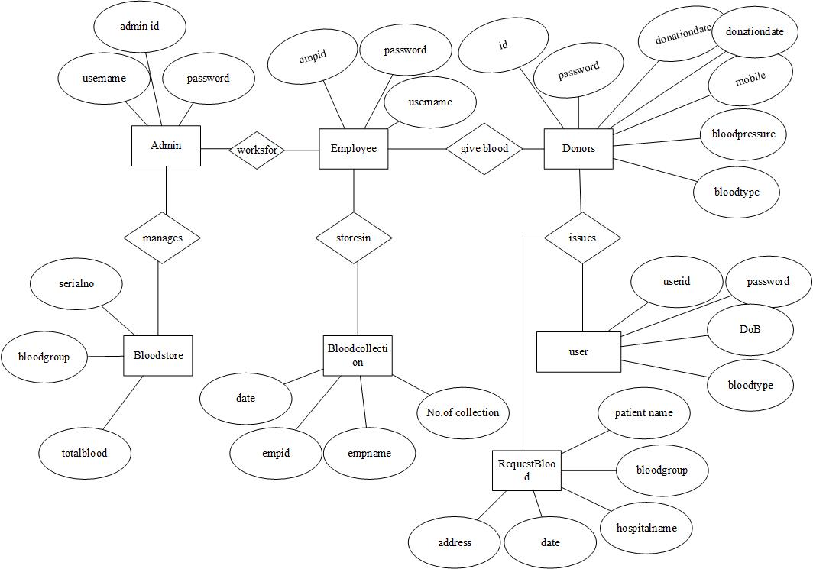
E-R DIAGRAM

Slide 13
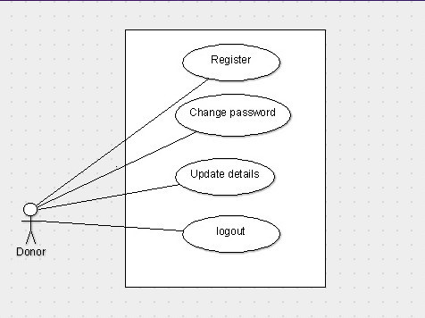
USECASE : DONORS

Slide 14
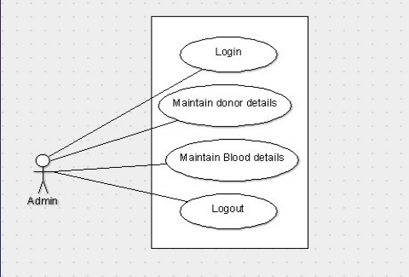
USECASE : ADMINISTRATOR

Slide 15


Slide 16
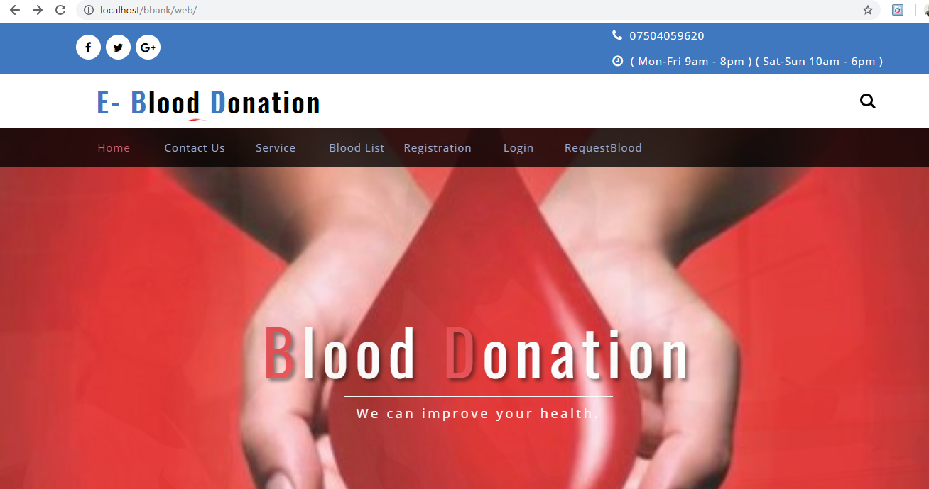
Home Page

Slide 17
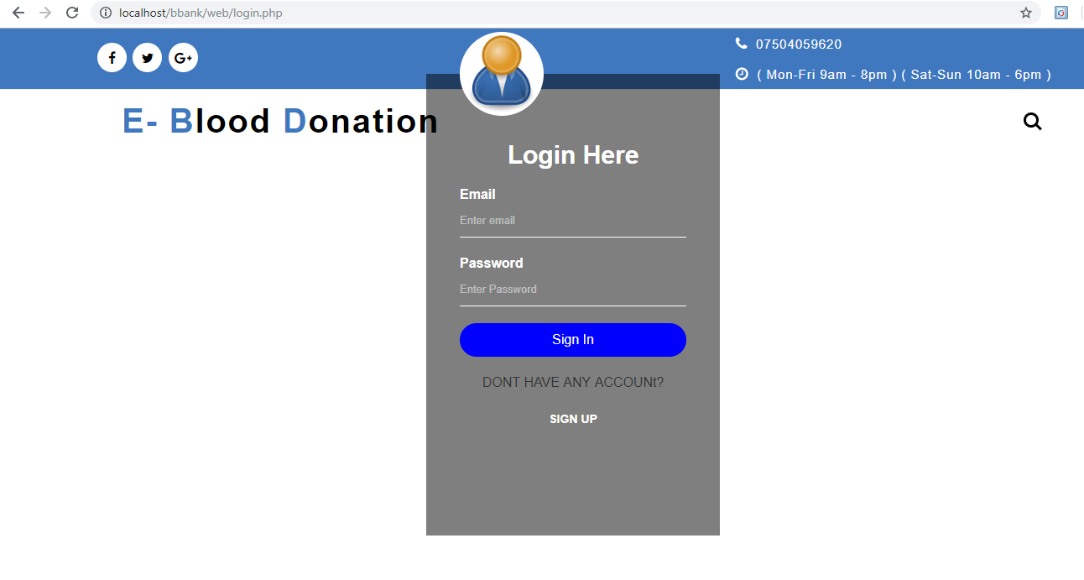
Login

Slide 18
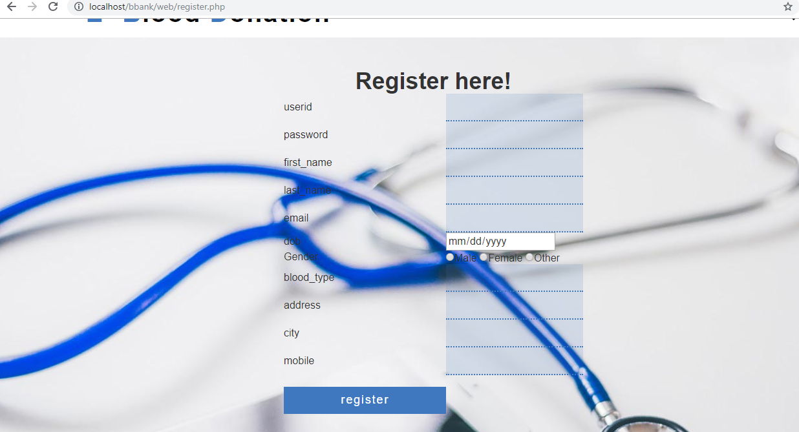
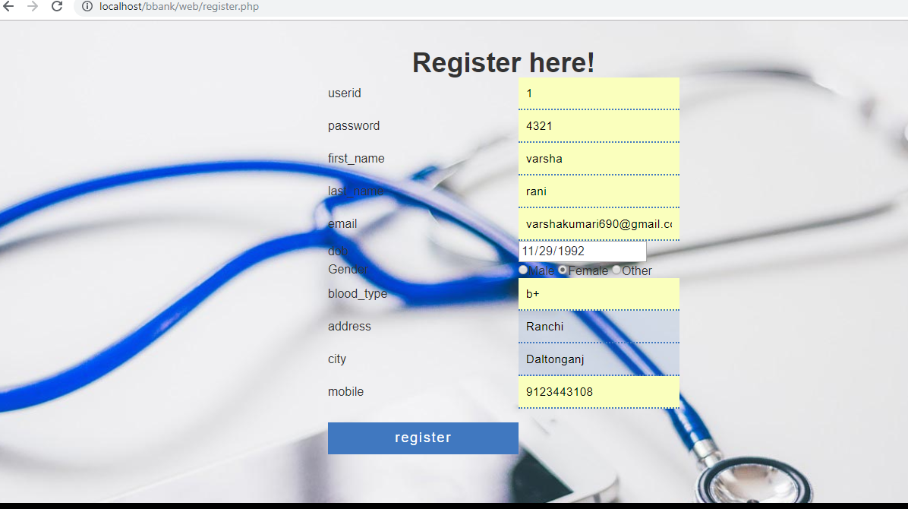
Registration

Slide 19
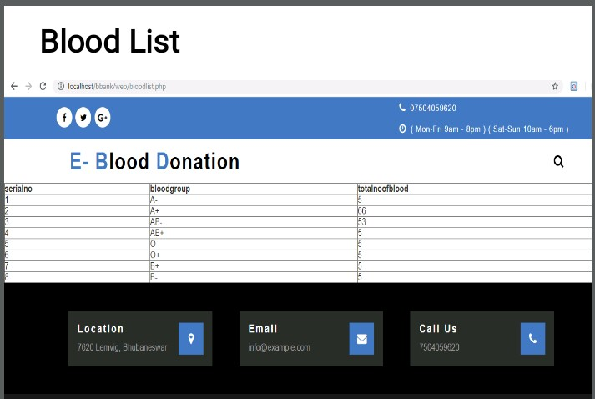
Blood List

Slide 20
CONCLUSION
Today the world is become a global village where every thing is online.
There are so many web based solutions provided in the market for the comfort of the people.
But without blood human being is non living, just by providing the web solution of blood bank management information system is just one more step in order to serve the mankind.

Slide 21
THANK YOU…

